Slide 1
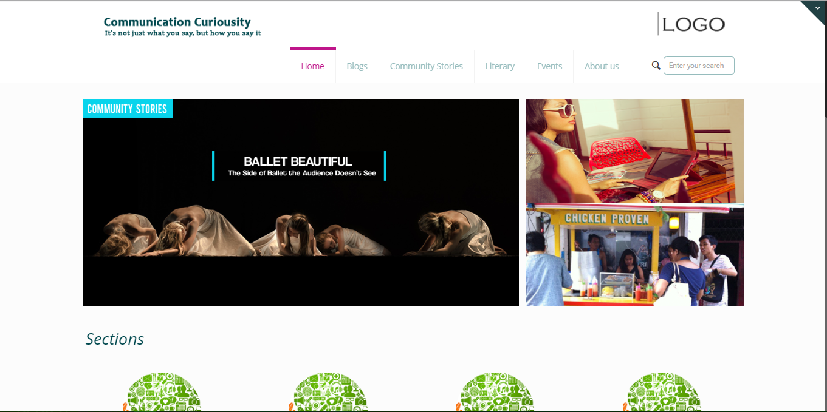
www.blank.com
PROPOSAL

Slide 2
Things to Discuss.
About the Website
Contents and Functionalities
Users
System’s Environment
Timing Plan

Slide 3
MAJOR FUNCTIONALITIES
HOME
BLOGS
COMMUNITY STORIES
EVENTS
ABOUT US
SEARCH ENGINE
ADVERTISEMENTS
USER’S DASHBOARD

Slide 4
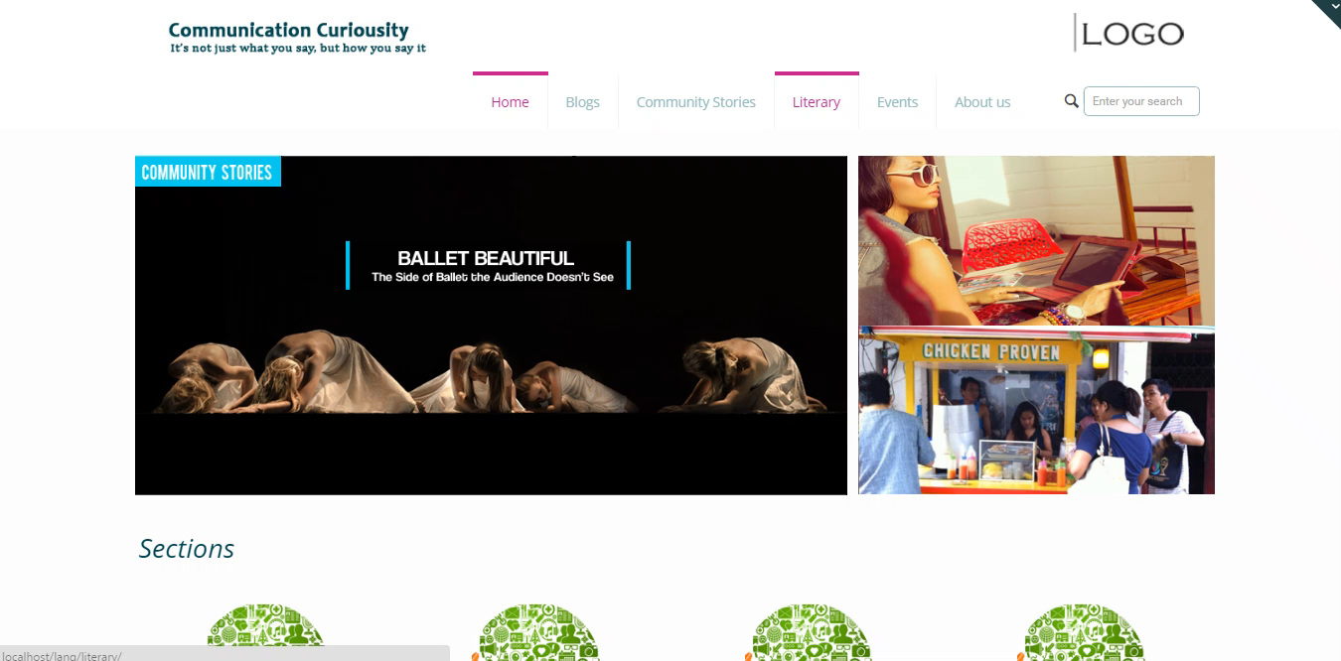
HOME
Header
Sliders
Sections
Latest Post
Who we are?
Get in Touch
Web Banner for advertisements
Footer

Slide 5
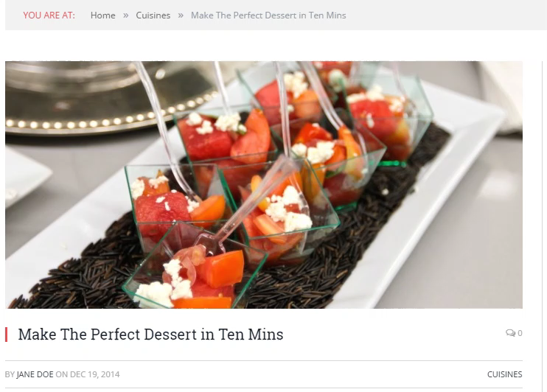
BLOGS
Category
Media Watch
Say It Right
Content
Header
Breadcrumps
Content
About the Author
Related Post
Comment
Footer

Slide 6
COMM. STORIES
Category
Features
Literary
Bulawanong Tunob
Content
Header
Breadcrumps
Content
About the Author
Related Post
Comment
Footer

Slide 7
EVENTS
CALENDAR OF ACTIVITIES OF DCLL
Create an event
Edit an event
Delete an event
* Event calendar automatically send an email to its organizer and subject participants. Only if both have registered email address.

Slide 8
ABOUT US
DCLL
DCLL Vision and Mission
Contact Information
ABOUT DCLL COURSES AND STUDENTS
Corporate Communication
Media
Linguistics
Literature
ABOUT THE SITE

Slide 9
SEARCH ENGINE
Search Option
By author
By title of the article
Specifications:
Search option will search all approved or reviewed articles.
Search results will be shown by its category (Blogs, Community Stories, Events).
It will be redirect to its category.

Slide 10
ADVERTISEMENTS
Will be displayed on the Homepage
Will be displayed always on the right side bar

Slide 11

USER’S DASHBOARD
Responsible for managing website users from registration, promote or
demote and lastly delete user(s).
System Administrator
Responsible for reviewing submitted articles by the contributors. He / She can
promote articles to be featured, approve for publishing, pending for revision,
and disapprove.
System Article Reviewers

Slide 12
USER’S DASHBOARD
Responsible for submitting new articles.
Contributors
Subject of the website.
Viewers

Slide 13
USER’S DASHBOARD
Published
Submit (revisions done)
New Article
Reviewed
Featured Suggestion
Featured
Articles
Pending for revision(s)

Slide 14
USER’S DASHBOARD
Manage Account Information
Manage Users
User’s Registration
Manage Users
View
Edit (promote or demote)
Delete
Update Personal Information
Login / Logout

Slide 15
USER’S DASHBOARD
User’s Task
Create Article
Processed Articles (For reviewers only)
View articles for review
View published articles
View suggested featured articles
View featured articles
My Articles
Update
Delete
View pending articles
View approved articles
View featured articles

Slide 16
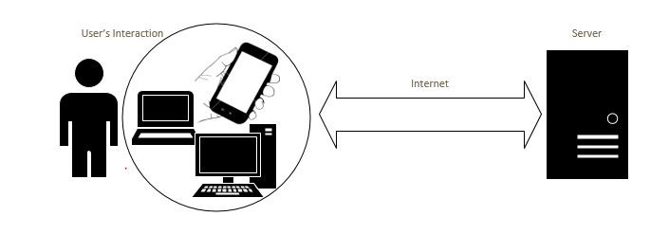
SYSTEM’S ENVIRONMENT

Slide 17
TIMING PLAN
August 2016
October 2016
December 2016
Phase 1: Initial Delivery
Phase 2
Phase 3: Milestone
* Purely Informative
Home
Blogs
Comm. Stories
Events(NF)
About Us
Enable social website link
Advertisements
Site Map
Events Calendar
User’s Dashboards
User’s Acceptance Test(UAT)
Project Delivery

Slide 18
Thank you.

